Slide 1


Predicting Apple Sweetness
Using Hybrid Machine Learning

Slide 2











Table of Contents
Team Members
Introduction
Collecting Data
Models
HML
Application
Future Plan
Reference

Slide 3
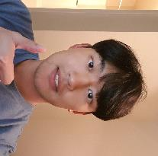


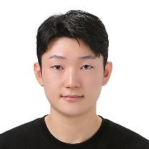




Introducing our Team Members
Heejun Park (YODA)
Yonsei Univ.
parkie0517@gmail.com
Taeyun Kim (KAMTAE)
Jeju Nat’l Univ.
persimm0ncrack@gmail.com
Hanbi Kim (PHOENIX)
Chungbuk Nat’l Univ.
hanbikim20@g.cbnu.ac.kr
Seokhyeon Heo (EASY)
Jeju Nat’l Univ.
gj4535@gmail.com
Jeongho Ha (JAY)
Jeju Nat’l Univ.
hjh4212@naver.com
Jeffrey Tsai (GOKU)
Purdue Univ.
jeffrey051622@gmail.com
Kyungrock Kwon (ROCK)
Purdue Univ.
kyungrock99@gmail.com

Slide 4


Introduction
Introduction
Problem statement

Slide 5
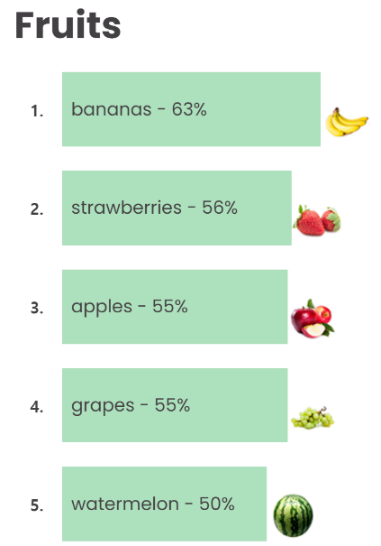
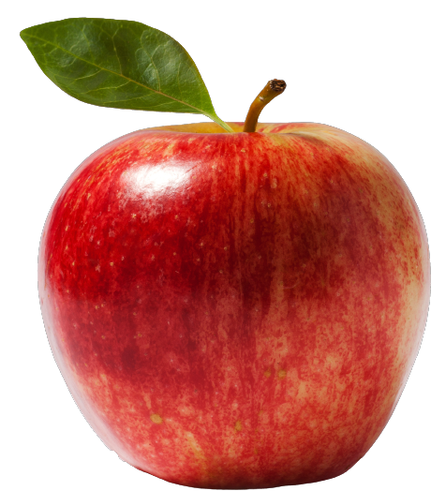

Introduction
Production & Demand of Apples in the US
4.3M Tons

Slide 6
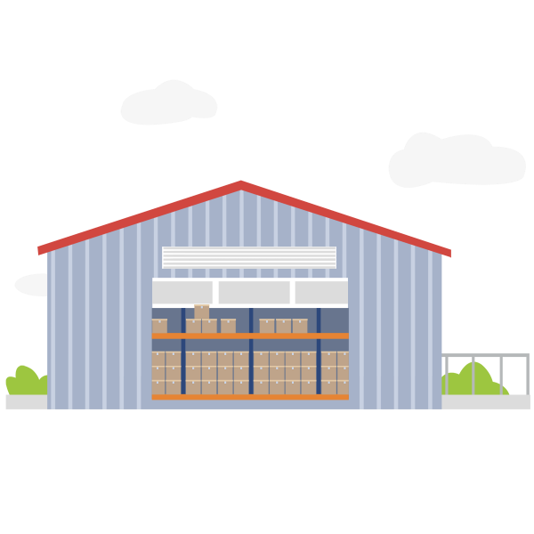
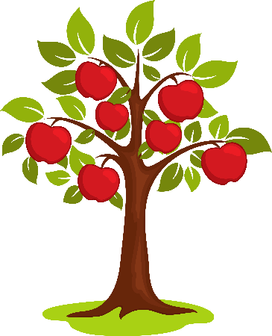
Introduction – Problem Statement
The Distribution process of apples

Slide 7
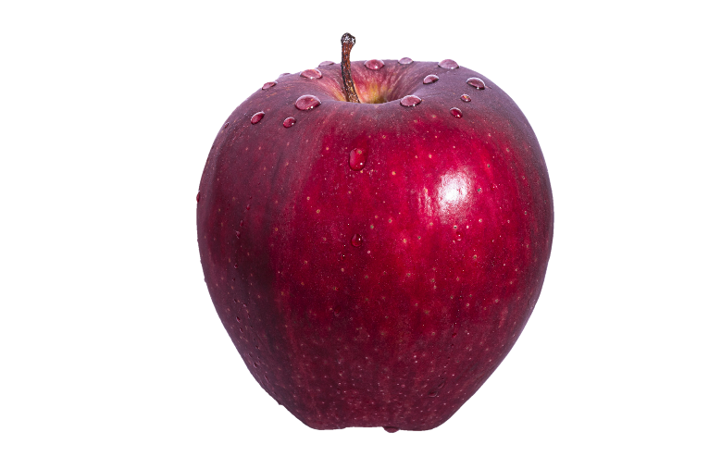
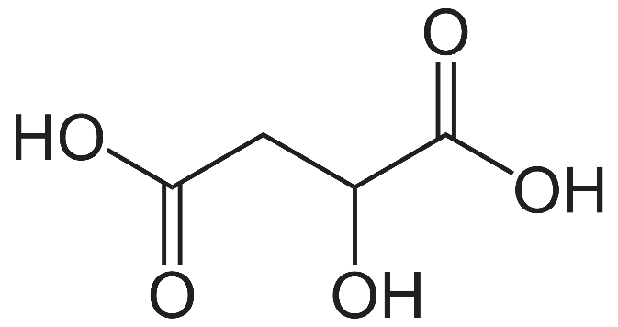

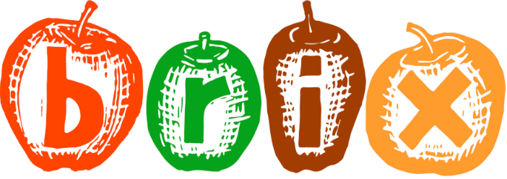
Introduction - Problem Statement
Farmer

Slide 8
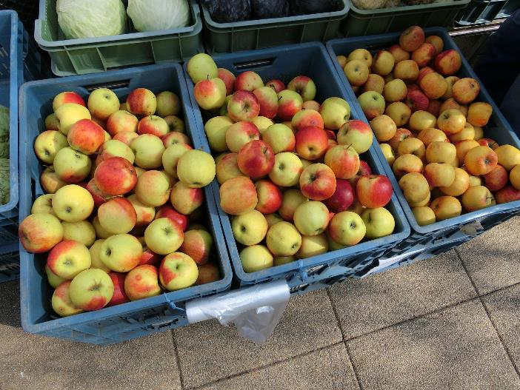

Introduction - Problem Statement
Consumer

Slide 9
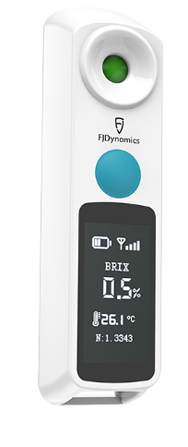
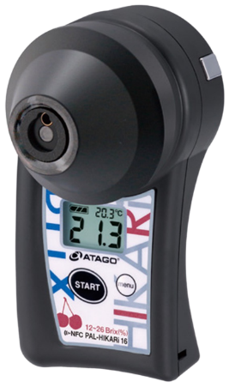
Introduction - Problem Statement
Two Ways of Measuring Apple Sweetness
Destructive
Method (DM)
Non-Destructive
Method (NDM)
DM | FEATURES | NDM
Affordable | Affordability | Expensive
Hard and Slow | Ease of Use | Simple and Fast
Damages Fruit | Preservation of Fruit | Preserves Fruit
Notes:
장점 어디서 뭘 뽑고 인공지능을 이용한 ndm 만들 것이다.
So, We will make non-destructive method using both method’s advantages.

Slide 10

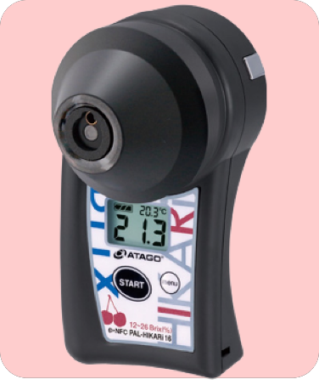

Application
Non-Destructive Method
Hybrid Machine Learning
Notes:
We will talk about why we use HML later.

Slide 11

Application + Non-Destructive method + Hybrid Machine Learning

Slide 12

Collecting Data
- Visual Data
- Measuring Apple Sweetness
- Making Dataset

Slide 13
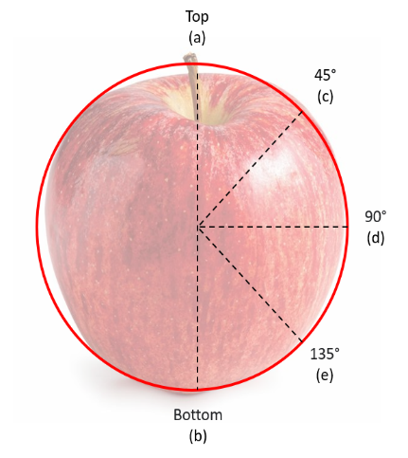
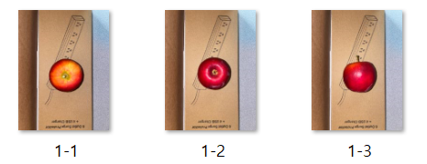
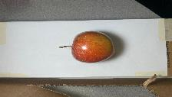
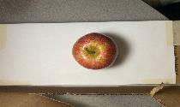
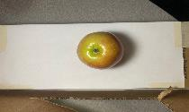
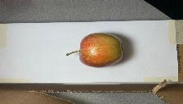
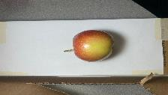
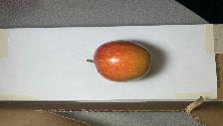
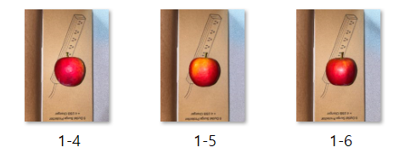
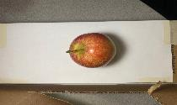
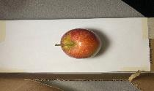
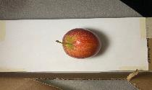
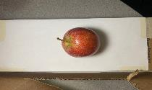
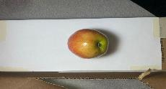
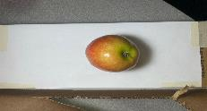
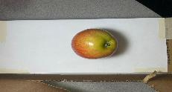
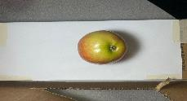
Collecting Data
1. Visual Data
(a)
18.5cm
18.5cm
1-7
1-1
1-2
26cm
1-8
1-9
1-10
(b)
3cm
3cm
After
1-3
1-4
1-5
1-6
38cm
1-11
1-12
1-13
1-14
Before
Apple Photo Studio
Notes:
왜 바꾸게 됐는지
Before We used 200 Pixie Crunch. We took 6 sides pictures of apple but our dataset was lacking.
Now, We used 815 Gala apples. We took 14 sides pictures of apple.
픽시크런치 200개 6개의 단면을 찍었지만, 데이터셋이 부족해서
갈라 815개의 14개의 단면을 찍었다.

Slide 14
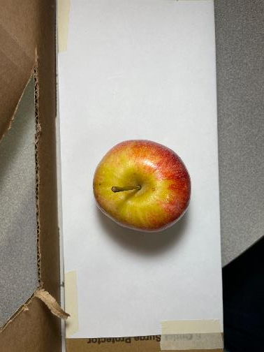
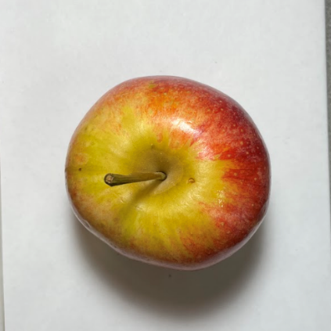
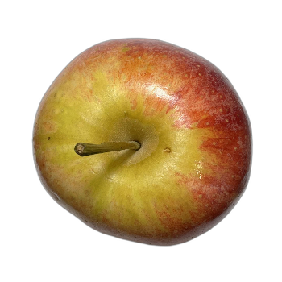
Collecting Data
1. Visual Data – pre-processing

Slide 15
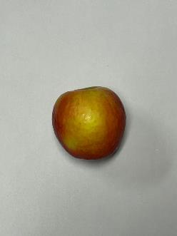
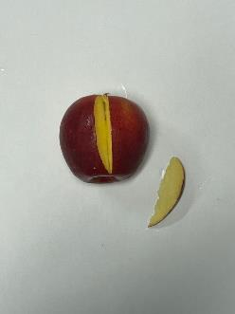
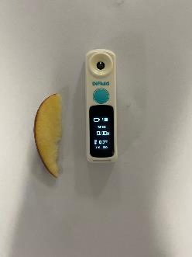
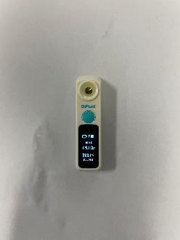
Collecting Data
2. Measuring Apple Sweetness
Range | Average
8.90 °Bx ~ 17.60 °Bx | 12.57 °Bx
(a) finding the reddist
cross-section
(b) Cutting that part
of the apple
(c) Squeezing the juice
out of the slices on
the sample dish
(d) Measuring the
sugar level

Slide 16
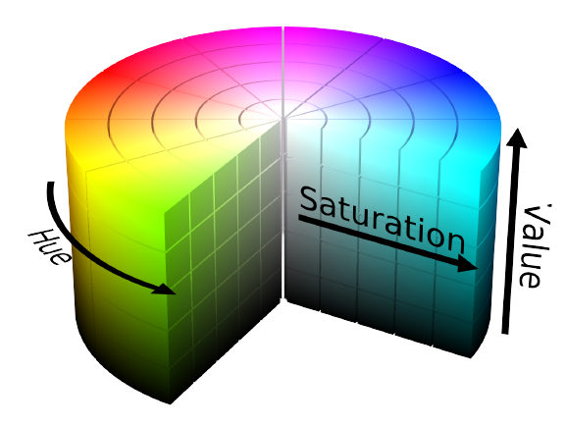

Collecting Data
3. Making Dataset – Machine Learning
RGB
HSV
Notes:
다른 피쳐값 넣기 / 질문 ?

Slide 17
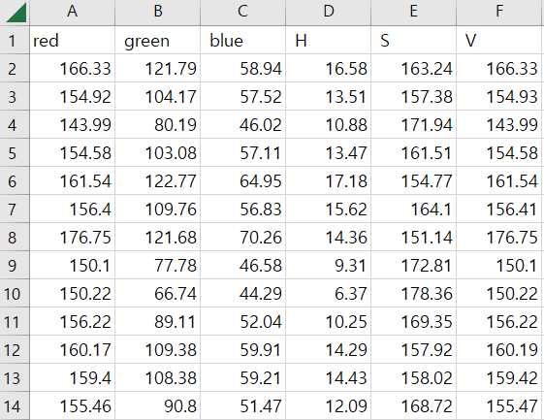
Collecting Data
3. Making Dataset – Machine Learning
Feature Extraction
a. Apple’s RGB value
b. Apple’s HSV value
Notes:
These data are recorded and stored in CSV files like this,
These are average of RGB and HSV values.
These data were mainly selected through a background knowledge and content from various related studies to this topic.
And by combining color spaces we could get other features such as the yellowest part.
these data are used for training and testing in machine learning model.
These data are average of RGB and HSV values.
These are recorded and stored in CSV files like this.

Slide 18

Models
- Machine Learning
- Deep Learning
- EfficientNet V2-L

Slide 19
Models – Machine Learning
Notes:
In machine learning, we built ten different models.MAE is mean squared error.
It is the average of the absolute values of the difference between the actual and predicted values.
Among these models, Random Forest showed the lowest MAE value, which means that this model has the best performance.

Slide 20
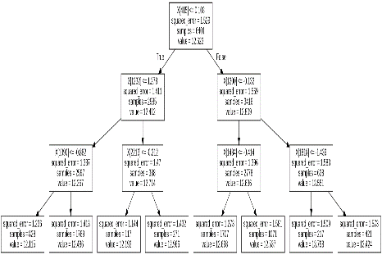
Models – Machine Learning Implementation
Estimators | Max Features | Max Depth
200 | 35 | 17
200 | 40 | 15
MAE | MSE | RMSE
0.8948 | 1.3042 | 1.1434
0.8965 | 1.3194 | 1.1462
Notes:
Random forest is a supervised machine learning algorithm. It is one of the most commonly used algorithms due to its accuracy, simplicity, and flexibility. And It can apply to various datasets and situations by combining nonlinear characteristics and facts that the model can be used for classification and regression operation.
We test the model by changing the parameter values to find the optimum parameters on the model. When the value of parameters are like this, the Random forest model showed the best Evaluation Metrics value.
The estimator is the number of trees. And Max feature is the number or proportion of features to be considered when branching trees. And max depth is the tree’s depth.

Slide 21
Models – Machine Learning Implementation
Feature | Importance
Least_red | 0.1458
S(HSV) | 0.1139
Red | 0.0939
V(HSV) | 0.0622
Most_red | 0.0502
Notes:
This is a table showing the five most important features among the features of the machine learning model.
Importance is the probability of how much this feature value was used for prediction.

Slide 22
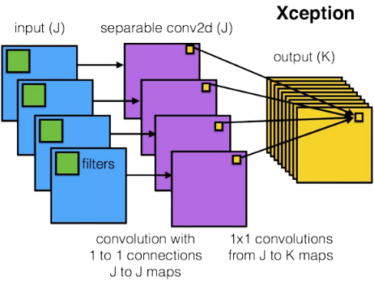
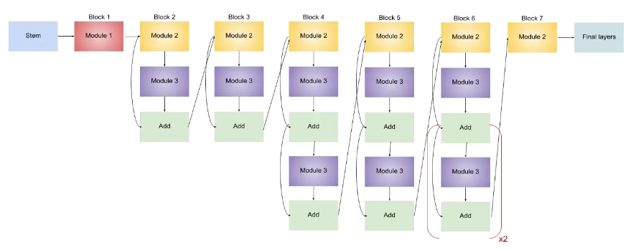
Models – Deep Learning
Xception
EfficientNet B0

Slide 23
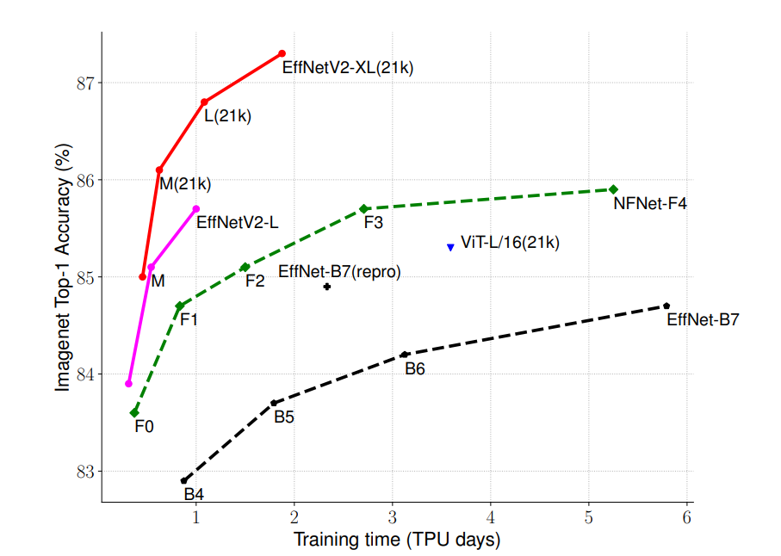
Models – Deep Learning Implementation
EfficientNetV2-L
Notes:
Let me explain EfficientNetV2. It is a model focused on training efficiency. This figure shows the training efficiency of EfficientNetV2 compared to other models, and the table next to it is the architecture of EfficientNetV2
EfficientNetV2 complements three problems of EfficientNet.
Training with very large image sizes is slow
Depthwise convolutions are slow in early layers
Equally scaling up every stage is sub-optimal
To solve these three problems, EfficientNetV2 uses progressive learning, fused-MBConv, and non-uniform scaling.

Slide 24
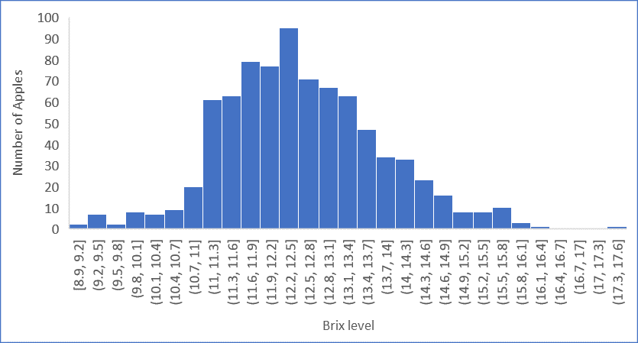
Models – EfficientNetV2-L
Pre-Processing
Medium
(12<= x <=13)
Low(<12)
High(>13)
Notes:
The Brix distribution for the measured apples in this research was between 8.90 °Bx to 17.60 °Bx, with an average of 12.57 °Bx. Most of the Brix values were between 12 °Bx to 13 °Bx.
so we defined less than 12 as low, more than 12 and less than 13 as medium, and more than 13 as high.

Slide 25
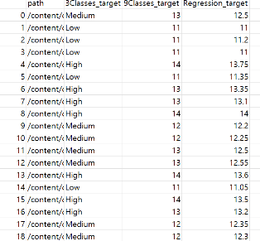
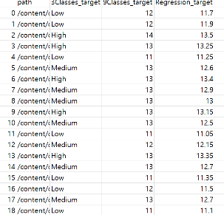
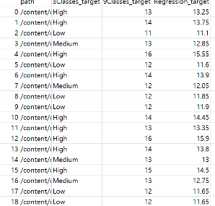
Models – EfficientNetV2-L
Pre-Processing
Train.csv
Valid.csv
Test.csv
Notes:
The Brix distribution for the measured apples in this research was between 8.90 °Bx to 17.60 °Bx, with an average of 12.57 °Bx. Most of the Brix values were between 12 °Bx to 13 °Bx.
so we defined less than 12 as low, more than 12 and less than 13 as medium, and more than 13 as high.

Slide 26
Models – EfficientNetV2-L
3Classes / 622 raws | Test accuracy | epoch | batch | Learning rate | Optimizer
StepLR | 33.83 | 23 | 16 | 1.00E-02 | Adam
ConsineAnnealing | 36.63 | 23 | 16 | 1.00E-02 | Adam
StepLR | 31.77 | 34 | 16 | 1.00E-05 | Adam
ConsineAnnealing | 56.18 | 34 | 16 | 1.00E-05 | Adam
Notes:
Train, validation, and test were divided into 6:2:2 and experimented by changing the initial learning rate with two learning rate schedulers, stepLR and CosineAnnealing.
As a result of the experiment, the best performance was found at 1e-5 with the consineannealing scheduler.

Slide 27
Models – EfficientNetV2-L
Pre-Processing
 | 6 : 2 : 2 | 8 : 1 : 1
Raw | 6:2:2_Raw dataset | 8:1:1_Raw dataset
Modified | 6:2:2_Modified dataset | 8:1:1_Modified dataset
 | Number of images
Raw | 11410
Modified | 10516
Notes:
We considered four situations with a total of two variables in the use of datasets. The first is the use of modified data due to data imbalance with overall raw data.
First is 8:1:1 and 6:2:2 divided by the train set, validation set, and test set.
And the second is brix distribution.
This table shows the brix distribution of raw data and modified data

Slide 28
Models – EfficientNetV2-L
Pre-Processing
 | Raw | Modified
Brix distribution | 8.90 Brix level ~ 17.60 Brix level | 10.7 Brix level ~ 14.8 Brix level
Notes:
We considered four situations with a total of two variables in the use of datasets. The first is the use of modified data due to data imbalance with overall raw data.
First is 8:1:1 and 6:2:2 divided by the train set, validation set, and test set.
And the second is brix distribution.
This table shows the brix distribution of raw data and modified data

Slide 29
Models – EfficientNetV2-L
3Classes | Test loss | Test accuracy | epoch | batch | Learning rate | Optimizer
622raw | 0.9365 | 57.67 | 10 | 16 | 1.00E-05 | Adam
622modified | 0.9765 | 51.83 | 10 | 16 | 1.00E-05 | Adam
811raw | 0.9257 | 59.86 | 10 | 16 | 1.00E-05 | Adam
811modified | 0.9559 | 53.71 | 10 | 16 | 1.00E-05 | Adam
Notes:
Although 622raw and 811raw showed good performance and 811raw data showed the best performance, considering the number of test sets, we decided to use 622raw data.
This is actual classes and this is predicted classes. So If the color of the boxes are closer to this color, it means that performance of the model is better.

Slide 30
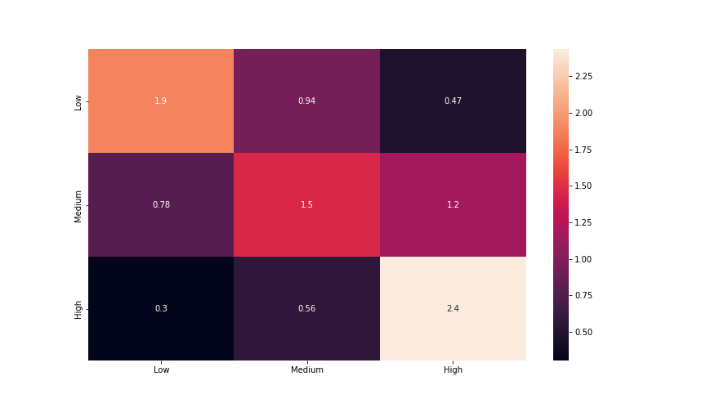
Models – EfficientNetV2-L
Notes:
Although 622raw and 811raw showed good performance and 811raw data showed the best performance, considering the number of test sets, we decided to use 622raw data.
This is actual classes and this is predicted classes. So If the color of the boxes are closer to this color, it means that performance of the model is better.

Slide 31
Models – EfficientNetV2-L
 | Test_loss | Test_accuracy
3Classes | 0.9365 | 57.67
9Classes | 1.1805 | 39.61
Linear Regression | 0.9235 | 41.58
Notes:
In addition to the three classes of low, medium, and high, apple sugar was rounded off to make nine integer classes, and nine classes and linear regression were made to compare test_loss and test_accuracy. As expected, the test_accuracy of 3 Classes was the highest.

Slide 32

Hybrid Machine Learning
- Structure
- Models
- Result

Slide 33

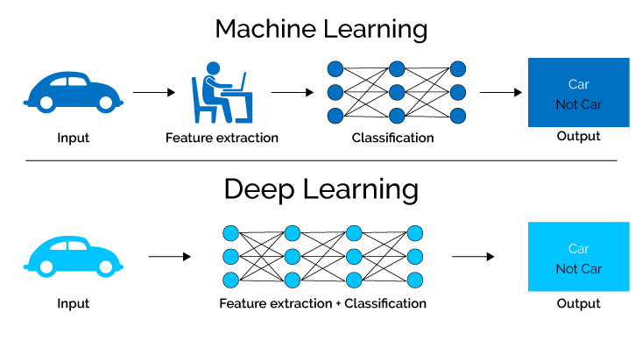
HML
Combining strengths
Feature Extraction
Notes:
Finally, our goal is to create a hybrid machine learning model.
We created this model because we thought that we could create a more accurate model by ensembling deep learning, which is strength in classification, and machine learning, which is strength in linear regression. In addition, looking at the difference between machine learning and deep learning, in machine learning, people do feature extraction, but in deep learning, models do it. Using these characteristics, we build a hybrid machine learning model that allows us to make more accurate sugar measurements by ensembling machine learning, which can directly specify sugar associated feature values for apple appearance based on basic natural science, and deep learning, which can directly find unknown associations.

Slide 34
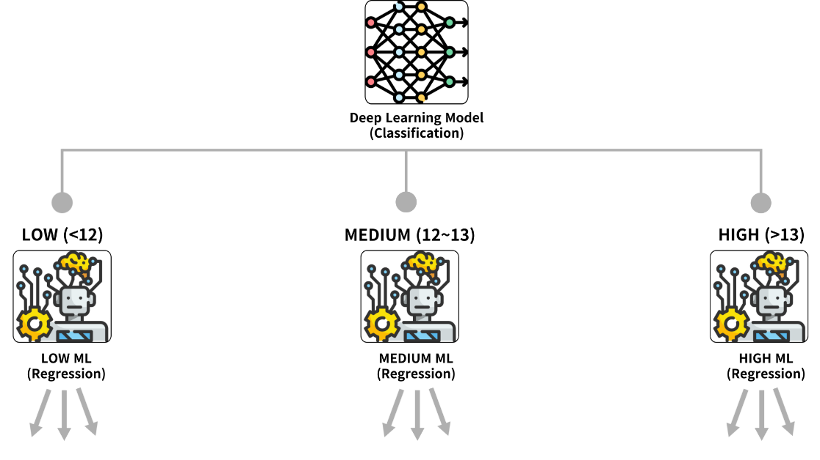
HML - Structure
Notes:
This figure structures how to ensemble machine learning and deep learning. First of all, the sugar level of apples is distinguished by low, medium, and high in the deep learning model, and the exact sugar level is predicted by regression in the machine learning model.

Slide 35
HML - Models
Machine Learning - Regression
Model | MAE | MSE | RMSE
Random Forest Regressor | 0.8948 | 1.3042 | 1.1434
Deep Learning - Classification
 | Test_loss | Test_accuracy
3 Classes | 0.9365 | 57.67
Notes:
This figure structures how to ensemble machine learning and deep learning. First of all, the sugar level of apples is distinguished by low, medium, and high in the deep learning model, and the exact sugar level is predicted by regression in the machine learning model.

Slide 36
HML - Result
Model | MAE | MSE | RMSE
HML Model | 0.8690 | 1.2793 | 1.1310

Slide 37
Application
- Architecture
- User Interface
- Implementation Video

Slide 38

Application - Architecture

Slide 39


Application – User Interface

Slide 40

Application - Implementation Video

Slide 41

Future Plan

Slide 42


Future Plan
1. Higher Accuracy
2. Deploy Server & Release App.
3. Apply to
various fruits

Slide 43

Reference
[1] U.S. Department of Agriculture. World Production, Markets, and Trade Report (2022, Jun, 14), Fresh Apples, Grapes, and Pears: World Markets and Trade. [Online]. Available: https://apps.fas.usda.gov/psdonline/circulars/fruit.pdf
[2] Schwallier. P, “Checking apple maturity: What to look for,” Michigan State Univ. Extension, Aug. 28, 2012. Accessed: Oct. 6, 2022. [Online]. Available: https://www.canr.msu.edu/news/checking_apple_maturity_what_to_look_for
[3] Kim, Seon-Jong, “Analysis of Apple Colors and Sugar Contents Using Linear Regression,” in Proc. The Journal of the Convergence on Culture Technology (JCCT) Vol. 8, No. 1, pp. 201-207, Jan. 2022. [Online]. Available: https://koreascience.kr/article/JAKO202208148789847.view?orgId=anpor&hide=breadcrumb,journalinfo
[4] M. A. J. Al-Sammarraie et al., “Predicting Fruit’s Sweetness Using Artificial Intelligence—Case Study: Orange,” in Proc. Applied Sciences, vol. 12, no. 16, p. 8233, Aug. 2022, [Online]. Available: https://doi.org/10.3390/app12168233

Slide 44
Reference
[5] Chu-Hui Lee and Jhih-Chen Jhou. “A Non-Invasive Method to Classify the Sweetness Levels of Apples,” in Proc. 2021 Artificial Intelligence and Virtual Reality (AIVR) (AIVR 2021) Association for Computing Machinery pp. 128–134, July 2021. [Online]. Available: https://doi.org/10.1145/3480433.3480453
[6] T. Ittatirut et al., "Apple Sweetness Measurement by image processing technique", 2016 Fifth ICT Int’l Student Project Conf. (ICT-IS; PC), Thailand, pp. 182-185, May 2016, [Online]. Available: https://ieeexplore.ieee.org/document/7519266
[7] S. K. Bejo et al., "Determination of Chokanan Mango Sweetness (Mangifera indica) Using Non-Destructive Image Processing Technique," Australian Journal of Crop Science (AICS), Jan. 2014, 8. 475-480, [Online]. Available: http://www.cropj.com/bejo_8_4_2014_475_480.pdf
[8] “Top 20 Fruits and Vegetables Sold in the U.S.,” International Fresh Produce Association, 12-Nov-2021. [Online]. Available: https://www.freshproduce.com/resources/consumer-trends/top-20/. [Accessed: 25-Oct-2022].

Slide 45
Reference
[9] “Linear regression,” Wikipedia, 23-Oct-2022. [Online]. Available: https://en.wikipedia.org/wiki/Linear_regression. [Accessed: 26-Oct-2022].
[10] “scikit-learn random forest,” Naver blog GodGo. [Online]. Available: https://m.blog.naver.com/samsjang/220979751089. [Accessed: 26-Oct-2022].
[11] “VGG-16: CNN model,” GeeksforGeeks, 24-Aug-2022. [Online]. Available: https://www.geeksforgeeks.org/vgg-16-cnn-model/. [Accessed: 26-Oct-2022].
[12] “Xception Architectural Design - coding,” Gitbook.io, 2022. https://stephan-osterburg.gitbook.io/coding/coding/ml-dl/tensorfow/ch3-xception/xception-architectural-design (accessed Dec. 13, 2022).
[13] V. Agarwal, “Complete Architectural Details of all EfficientNet Models,” Medium, May 31, 2020. https://towardsdatascience.com/complete-architectural-details-of-all-efficientnet-models-5fd5b736142

Slide 46
Reference
[14] “RGB Color Model | How It Work | Uses & Example | Advantages,” EDUCBA, Jun. 08, 2019. https://www.educba.com/rgb-color-model/
[15] Wikipedia Contributors, “HSL and HSV,” Wikipedia, Jun. 23, 2019. https://en.wikipedia.org/wiki/HSL_and_HSV
[16] M. Tan and Q. Le, “EfficientNetV2: Smaller Models and Faster Training.” [Online]. Available:https://arxiv.org/pdf/2104.00298.pdf
[17] S. Mahapatra, “Why Deep Learning over Traditional Machine Learning?,” Medium, Jan. 22, 2019. https://towardsdatascience.com/why-deep-learning-is-needed-over-traditional-machine-learning-1b6a99177063

Slide 47
Reference
[18] “Yolo Object Detection Logo”, PngAAA. [Online]. Available: https://www.pngaaa.com/detail/3594055. [Accessed:12-Dec-2022]
[19] “Stayman Winesap Apple Tree”, ISONS Nursery & Vineyards. [Online]. Available: https://www.isons.com/shop/fruit-trees/apple-trees/stayman-winesap-apple-tree/. [Accessed:12-Dec-2022]
[20] “Amazon Web Services”, Wikipedia. [Online]. Available: https://en.wikipedia.org/wiki/Amazon_Web_Services. [Accessed:12-Dec-2022]
[21]“Fruit image” ,unsplash, 16-JAN-2021. [Online]. Available: https://unsplash.com/photos/M_xIaxQE3Ms. [Accessed:12-Dec-2022]

Slide 48


Thank You
Any Question?

